Slide 1

The Conspiracy Theorist Mind
And what does he do in his pastime?
Yehonatan Koritny

Slide 2

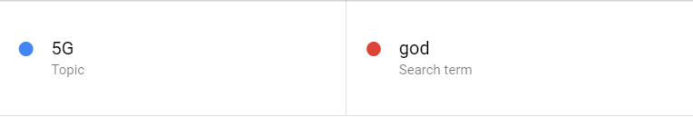
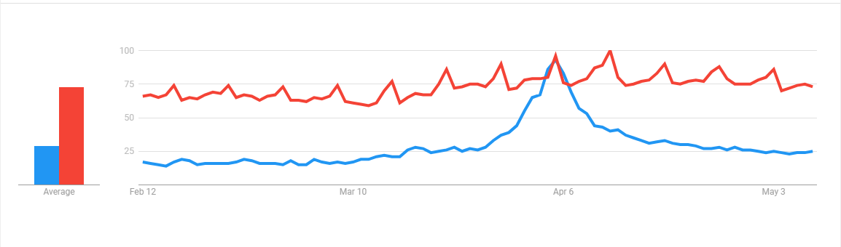
\

Slide 3
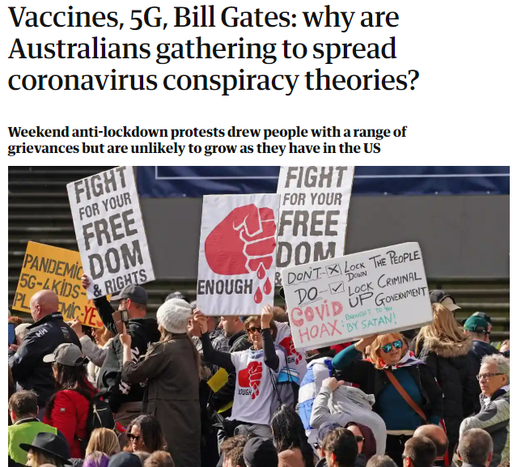
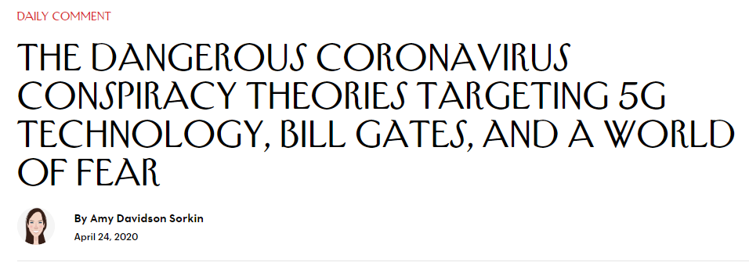
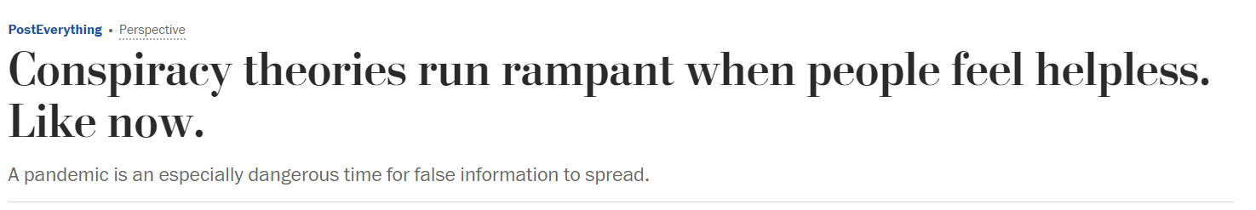

Slide 4
The Conspiracy Theory
“ A theory that explains an event or set of circumstances as the result of a secret plot by usually powerful conspirators” - Merriam-Webster

Slide 5
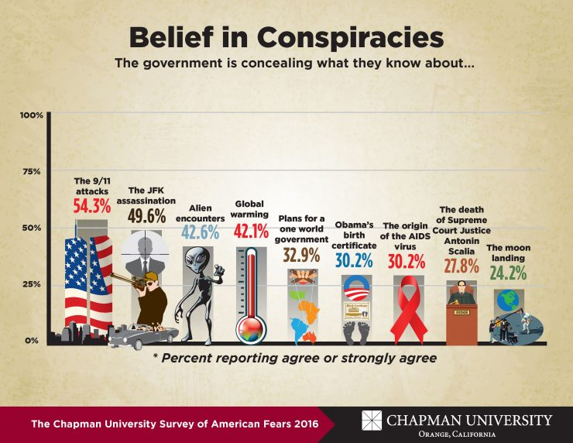
The Conspiracy Theory
“ A theory that explains an event or set of circumstances as the result of a secret plot by usually powerful conspirators” - Merriam-Webster

Slide 6
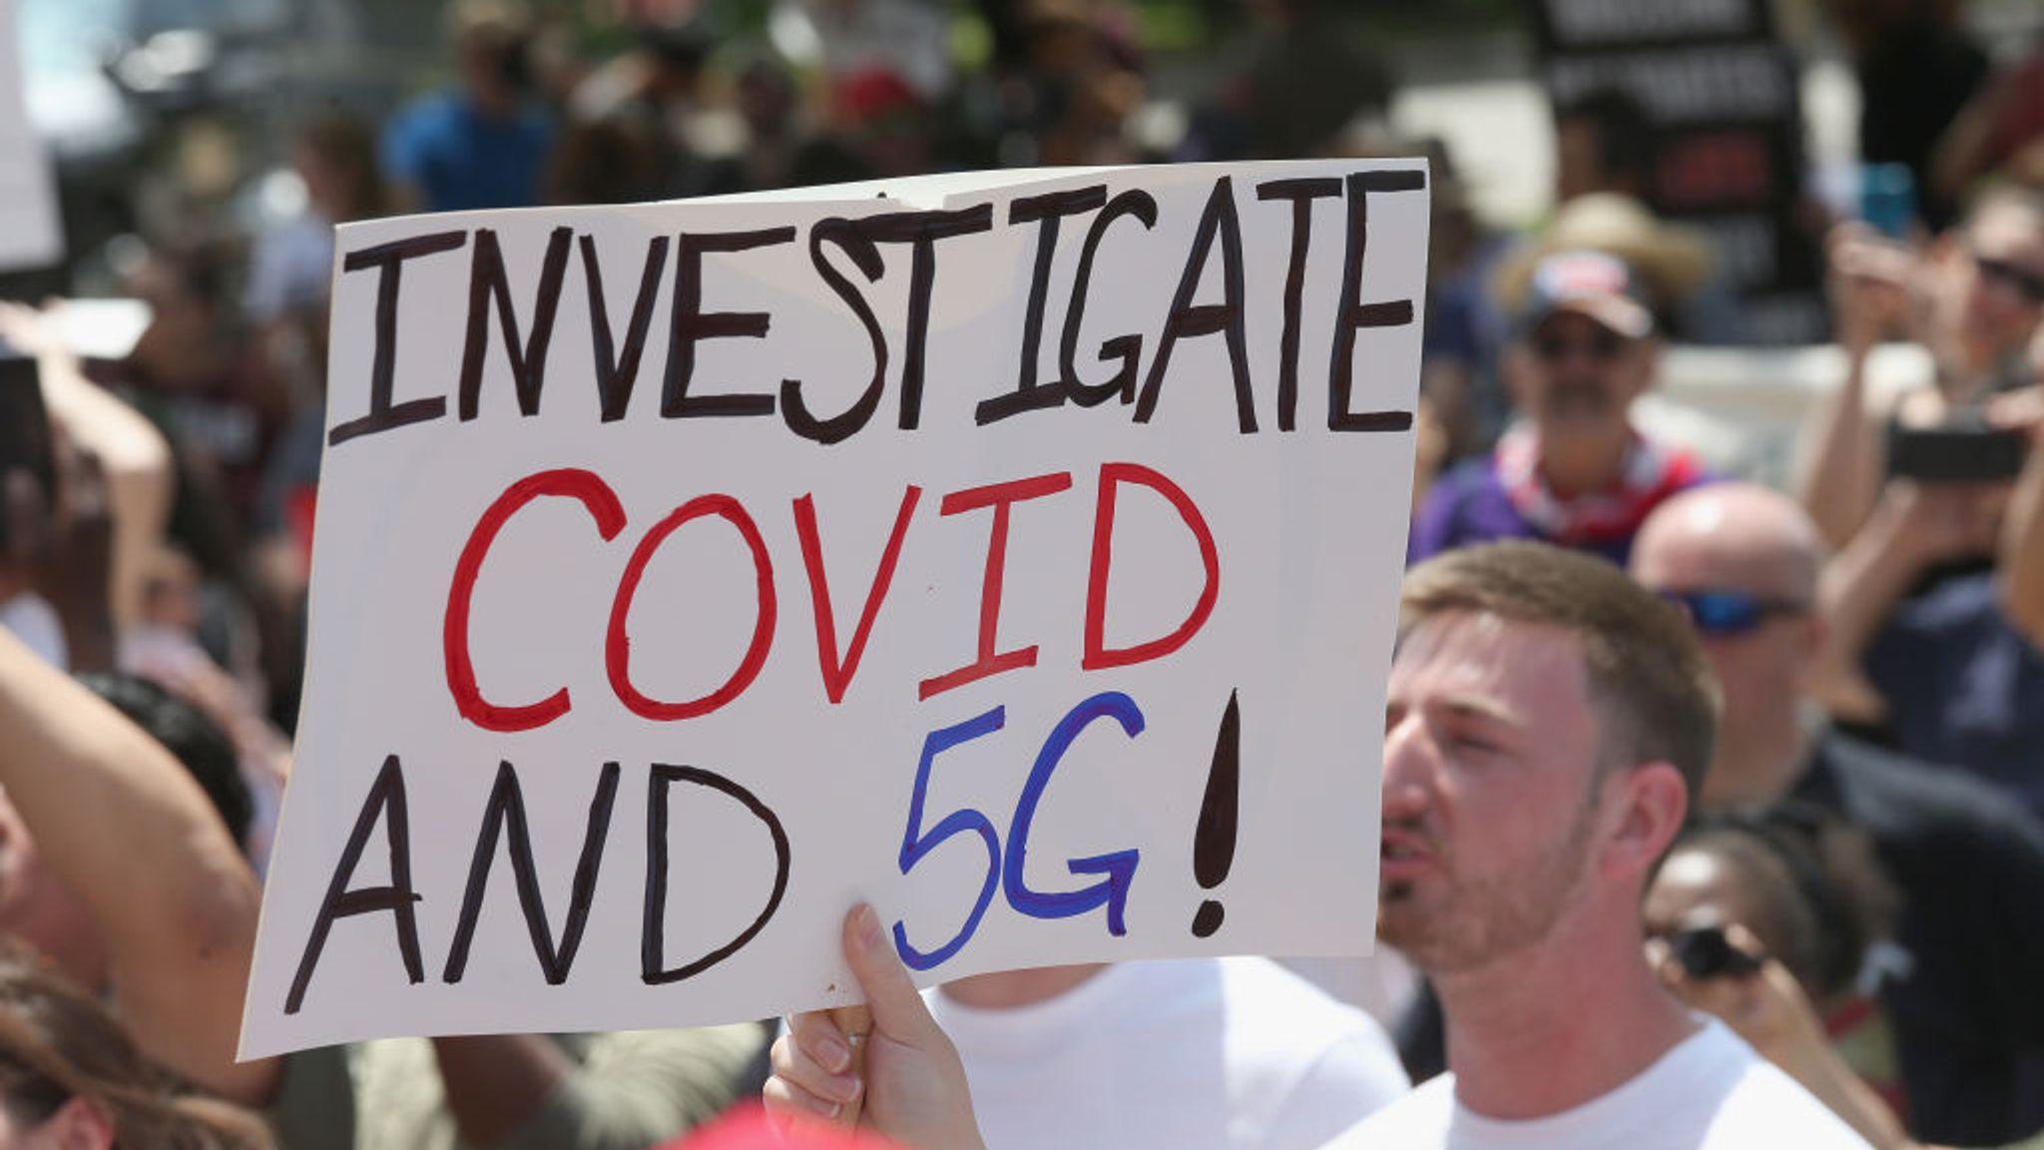
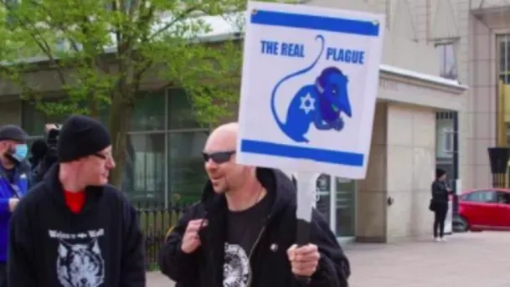
What are the dangers?
Generally:
Impact people’s view of scientific findings
Legitimate political out-groups
Spread hatred and racist ideas
Fake News
Specifically:
Decrease people’s willingness to get vaccinated
Decrease people’s willingness to comply with social distancing directives

Slide 7
The conspiracy Theorist

Slide 8
The conspiracy Theorist
Machiavellianism
Paranoia
Schizotypy

Slide 9
The conspiracy Theorist
Machiavellianism
Paranoia
But does he play
LOL or Overwatch?
Schizotypy

Slide 10
What does the psychologist say?
Conspiracy Theory Psychology
Individual Differences, Worldviews, and States of Mind
Michael J. Wood
Karen M. Douglas
DOI:10.1093/oso/9780190844073.003.0016
“…Other work has looked at predicting conspiracy theory belief from broad personality traits. These investigations have produced conflicting results…”
The two personality traits most often found to be connected to conspiracy belief are agreeableness and openness to experience…
more modest, compliant, and empathic are likely to reject conspiracy theories, as well as people who are less creative and open-minded.
However, there have also been studies showing no independent relationships between conspiracy beliefs and either openness to experience or agreeableness.
At the moment it is not completely clear how personality predicts conspiracy belief…”

Slide 11





Goal
Can we find people who are more gullible by studying their likes, interests, groups, shares etc…

Slide 12

Data collection / data processing
The source of the data: Reddit / activity on certain subreddits Features : Which other subreddits are they active on
Labels - 3820 Reddit users, labeled about half and half:
Gullible for being active on the subreddits :
"woke", "illuminati", "conspiracy", "ConspiracyII", "conspiracytheories", "Covid19Conspiracy", "conspiracies"
Skeptical for being active on the subreddits:
"Qult_Headquarters", "QAnonCasualties", "insanepeoplefacebook", "skeptic"
Training set- ¾ of the database. Test set - ¼ of the database. All picked randomly

Slide 13
Machine Learning Setup
Input A matrix with 400+ subreddits: 1 – subscribed to, 0 – not subscribed to
Output 1 – gullible, 0 - Skeptical
Algorithm – Logistic Regression Classification

Slide 14
Results
Total users = 3820
False Positive = 926
False Negative = 0
Success rate: 76 %
Highly correlated with being gullible | Neutral subreddits | Highly correlated with being skeptic
gonewild | news | conspiratard
FreeKarma4U | WhitePeopleTwitter | hockey
leagueoflegends | unpopularopinion | psychology
anime | movies | overwatch
Economics | instant_regret | PoliticalDiscussion
toptalent | depression | Military

Slide 15


Possible Application
Run algorithm on Facebook servers
is_gullible = True
Give hidden classification to every user

Slide 16
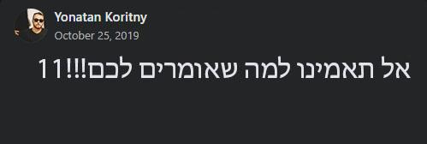
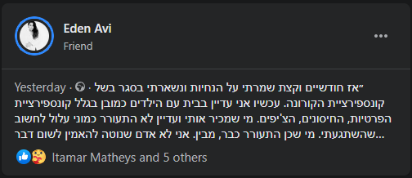
Possible Application
Reported
Hidden
Automatically report conspiratory posts
Hide conspiratory posts from his Timeline

Slide 17
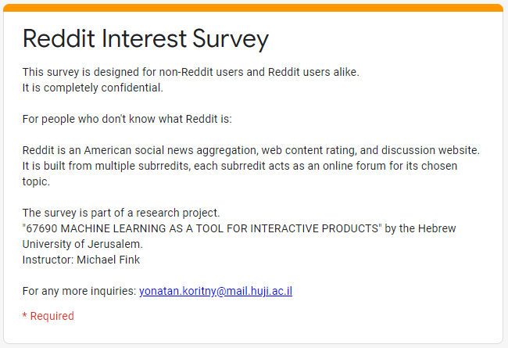
Survey
Reddit interest survey: https://forms.gle/6N2LMArTpftt5B5i7

Slide 18
Survey
Reddit interest survey: https://forms.gle/6N2LMArTpftt5B5i7
Part 1 - Pick seven out of 20 subreddits
Part 2 - Answer “conspiracy belief” survey

Slide 19
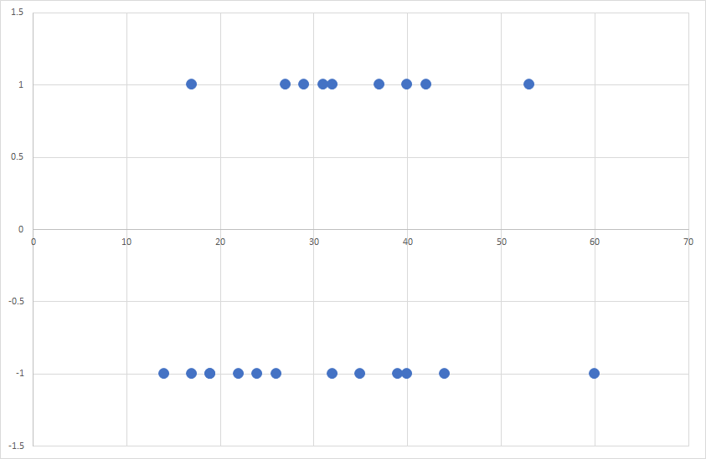
Survey Results
Gullible
Conspiracy Belief Score
Skeptical

Slide 20
Survey Results
Possible Threshold
Gullible
Conspiracy Belief Score
Skeptical

Slide 21
Survey Results
Possible Threshold
Gullible
Dataset too small.
Only 20 reddits to pick from.
Survey written for people in the USA.
Observable behaviours vs self-proclaimed behaviours.
Conspiracy Belief Score
Skeptical

Slide 22
Summary – Research and IML
Although researchers say it is hard to find what correlates conspiracy gullibility to personality –
my research does find some correlation.
More research should be done on the matter and could potentially filter conspiracy theories dangerous propaganda from people who are more susceptible in believing it.
IML standpoint –
Working with an API of a popular website.
Finding the right algorithm is a tricky thing to do.
Reading and writing data analytics.

Slide 23
Future work
Try to do the same on twitter or facebook, where more non-techie people browse the web.
Implement the same idea with a different algorithm – KNN, Decision Tree etc..
Find words that a conspiracy theorist use the most.

